Slide 1
Hour of Code
Workshop
Mercy Bodarky, Carlos Fonseca, Lorraine Herger, Alexandra Guffey, Shekeba Moshref, Michael Santos, Mark Sobierajski, Nikita SufiaKarim
March 29, 2019

Slide 2

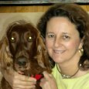



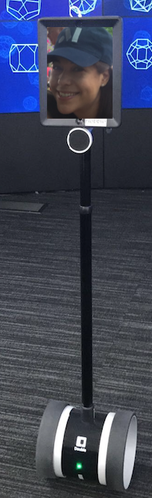
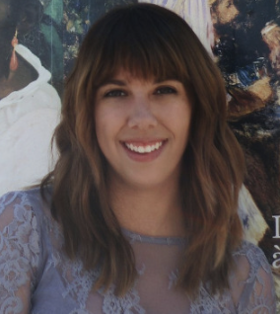


Meet our Workshop Team
Carlos Fonseca
Lorraine Herger
Michael Santos
Shekeba Moshref
Alexandra Guffey
Nikita Karim
Mark Sobierajski
Mercy Bodarky
Notes:
Shalisha Witherspoon/US/IBM@IBM, Shekeba Moshref/Watson/IBM@IBMUS, Shonda Adena Witherspoon/US/IBM@IBM
Aditi Agarwal25/US/IBM@IBM, Alice Song1/US/IBM@IBM, Carlos A Fonseca/Watson/IBM@IBMUS, John Walter/Watson/Contr/IBM@IBMUS, Lisa Ungar/Watson/IBM@IBMUS, Lorraine M Herger/Watson/IBM@IBMUS, Michael Sava/Watson/IBM@IBMUS, Nikita Sufia Karim/US/IBM@IBM, Shalisha Witherspoon/US/IBM@IBM, Shekeba Moshref/Watson/IBM@IBMUS, Shonda Adena Witherspoon/US/IBM@IBM

Slide 3
Agenda
TJ Bots Demos
Coding Exercise
Supplies for TJ Bot
Q &A, Raffle

Slide 4
JavaScript Overview
Variables
Strings, var name = "Johnny";
integers , var age = 24;
Functions, , function myFunction(a, b) { // do something }
Function variables
Function returns
var x = myFunction(4, 3); // Function is called, return value will end up in x
function myFunction(a, b) { return a * b; // Function returns the product of a and b }
Objects
Variables
Functions
Formatting and Semicolon ; ; ; ; ; ; ; ; ;

Slide 5
IBM Watson Services
Sign up for a free IBM Cloud Account
https://console.bluemix.net
Speech to text
Text to speech
Assistant (conversation)
Translator

Slide 6
Activity Instructions
Launch Chrome Browser and go to https://my-tjbot.mybluemix.net
Click on the .env tab on the upper left. Copy the API keys from the api-keys.txt file on your desktop and paste it in the code box in the simulator
Click on the app.js tab in the upper left and then click on the Docs tab in the upper right.
Scroll to shine(color) function. Double click on the box below the function to copy the JavaScript code to the editor box
Click on the TJBot tab in the upper middle/left.
Click on the Run button to see what happens to the robot
Clear the editor and try different functions
Try combining functions

Slide 7
Activity Instructions
What are all the functions you need to code a TJBot like Johnny?
Listen
Speak
Converse
Copy the content from the tjbot-example.js on github to the simulator editor and then run it.

Slide 8
TJ Bot Supply List
Raspberry Pi 3 + SD card preloaded with NOOBS. This is a required component to make TJBot work! 🤖
USB Microphone. Other brands of USB microphones should also work.
Mini Bluetooth Speaker. Any small speaker with either a 3.5mm audio jack or Bluetooth will work. Note that if you are using the 3.5mm audio jack, you may wish to add a USB Audio Adapter to avoid audio interference with the LED.
Servo Motor. Note that the red (middle) wire is 5v, the brown wire is ground, and the orange wire is data.
NeoPixel RGB LED (8mm). If you are using other kinds of LEDs, you may need to add a resistor; this LED doesn’t require one.
Female-to-female + female-to-male jumper wires. TJBot will only need 3 of each type, so you’ll have extra.
Raspberry Pi Camera. Either the 5MP or 8MP camera will work.
Note: Not all of these are required for all recipes.

Slide 9
TJ Bot Watson Maker Kit
https://www.sparkfun.com/products/14515 $125.00
https://www.adafruit.com/product/3462
Note: Not all of these are required for all recipes.

Slide 10
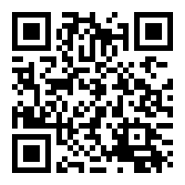
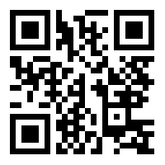
Links & Information
TJBot Hour of Code
IBM TJ Bot (3d Print TJ Bot, Code, recipes and more)

Slide 11
Thank you for visiting
IBM TJ Watson Research Center

